Slide 1
DEEPAK ROSHAN J
Keylogger using python
3/21/2024 Annual Review

Slide 2
PROJECT TITLE
Keylogger using python.
3/21/2024 Annual Review

Slide 3


AGENDA
Identify the goals and objectives of the keylogger project.
Determine the target platform and programming language for the keylogger.
Design and develop the keylogger software, including features such as capturing keystrokes, screenshots, and system information.
Implement stealth and security features to ensure the keylogger remains undetectable and secure.
Test the keylogger software extensively to ensure it functions correctly and meets the project requirements.
3/21/2024 Annual Review

Slide 4

PROBLEM STATEMENT
Keyloggers are powerful tools that record keystrokes, mouse movements, and other activities performed on a computer or mobile device. While keyloggers have legitimate uses in areas such as parental control, employee monitoring, and forensic investigations, they also pose significant privacy and security risks if misused or deployed maliciously. The challenge lies in developing a secure keylogger system that balances the need for monitoring with privacy protection and ethical considerations.
3/21/2024 Annual Review

Slide 5

PROJECT OVERVIEW
Keyloggers are malicious software programs that are designed to record a user's keystrokes on a computer, capturing sensitive information such as passwords, credit card numbers, and personal messages. The main goal of this project is to research and analyze their methods of deployment.
3/21/2024 Annual Review

Slide 6

WHO ARE THE END USERS?
Employers and Managers: Employers may deploy keyloggers on company-owned devices to monitor employee productivity, detect insider threats, and prevent data breaches. Keyloggers can provide insights into employee behavior, including time spent on work-related tasks and adherence to company policies.
Law Enforcement and Investigators: Law enforcement agencies and forensic investigators may utilize keyloggers as part of criminal investigations to gather evidence, track suspect activities, and uncover illicit activities such as hacking, fraud, or cybercrime.
Cybersecurity Professionals: Cybersecurity professionals may use keyloggers for penetration testing, vulnerability assessments, and security audits to identify weaknesses in systems and networks. Keyloggers can help simulate real-world attack scenarios and evaluate the effectiveness of security measures.
Security Consultants and Penetration Testers: Security consultants and penetration testers may utilize keyloggers as part of security assessments and risk management initiatives for clients. Keyloggers can help identify vulnerabilities, assess user awareness, and enhance overall security posture.
Ethical Hackers and White-Hat Researchers: Ethical hackers and white-hat researchers may use keyloggers to identify security weaknesses in software applications, websites, or systems. Keyloggers can aid in uncovering vulnerabilities related to authentication mechanisms, data handling practices, and user interactions.
3/21/2024 Annual Review

Slide 7

YOUR SOLUTION AND ITS VALUE PROPOSITION
Endpoint Security Software: Deploy robust endpoint security solutions, including anti-malware, anti-spyware, and intrusion detection systems (IDS), capable of detecting and blocking keyloggers and other malicious software. Regularly update and patch security software to ensure protection against the latest threats.
Secure Authentication Mechanisms: Implement multi-factor authentication (MFA) and strong password policies to reduce the impact of keyloggers on credential theft. Encourage the use of biometric authentication, hardware tokens, or one-time passwords (OTP) to enhance security and mitigate the risk of unauthorized access.
Behavior-Based Anomaly Detection: Utilize behavior-based anomaly detection techniques to identify unusual patterns of user activity that may indicate the presence of keyloggers or other malicious behavior. Monitor system logs, network traffic, and user behavior analytics (UBA) to detect suspicious activities and potential security breaches.
Data Encryption and Secure Communication: Encrypt sensitive data at rest and in transit using strong encryption algorithms and secure communication protocols (e.g., TLS/SSL). Implement encryption for email communications, file transfers, and remote access to protect against eavesdropping and data interception by keyloggers.
Regular Audits and Security Assessments: Conduct regular security audits, vulnerability assessments, and penetration tests to identify and remediate security weaknesses that could be exploited by keyloggers. Engage third-party security experts to perform comprehensive assessments and provide recommendations for improving security posture.
3/21/2024 Annual Review

Slide 8

THE WOW IN YOUR SOLUTION
Enhanced Cybersecurity Awareness: Ethical use of keyloggers in cybersecurity training and awareness programs can help organizations educate employees about the risks of phishing, social engineering, and other cyber threats. By simulating real-world attack scenarios and demonstrating how keyloggers can be used to steal sensitive information, organizations can raise awareness and promote best practices for cybersecurity hygiene. This proactive approach to security awareness empowers individuals to recognize and mitigate potential threats, eliciting a "wow" response from participants who gain valuable insights into cybersecurity risks and countermeasures.
3/21/2024 Annual Review

Slide 9
MODELLING
Modeling a keylogger project involves designing and implementing the software to capture and record keystrokes on a target device. Here are the key steps involved in modeling a keylogger project:
1. Define the project goal: Determine the purpose of the keylogger project and the target platform(s) it will be designed for (e.g., Windows, macOS, Android, iOS).
2. Choose a programming language: Select a programming language that is suitable for developing the keylogger software. Common languages used for keylogger projects include C++, Python, and Java.
3. Design the keylogger functionality: Plan the features and functionality of the keylogger software, such as capturing keystrokes, recording text input, taking screenshots, and sending logs to a remote server.
4. Implement the keylogger: Write the code to capture keystrokes using operating system APIs or hooks, record the keystrokes to a log file, and include any additional features that were planned.
5. Test the keylogger: Test the keylogger software on the target platform(s) to ensure that it functions correctly and captures keystrokes as expected. Check for any bugs or errors and make necessary fixes.
3/21/2024 Annual Review

Slide 10
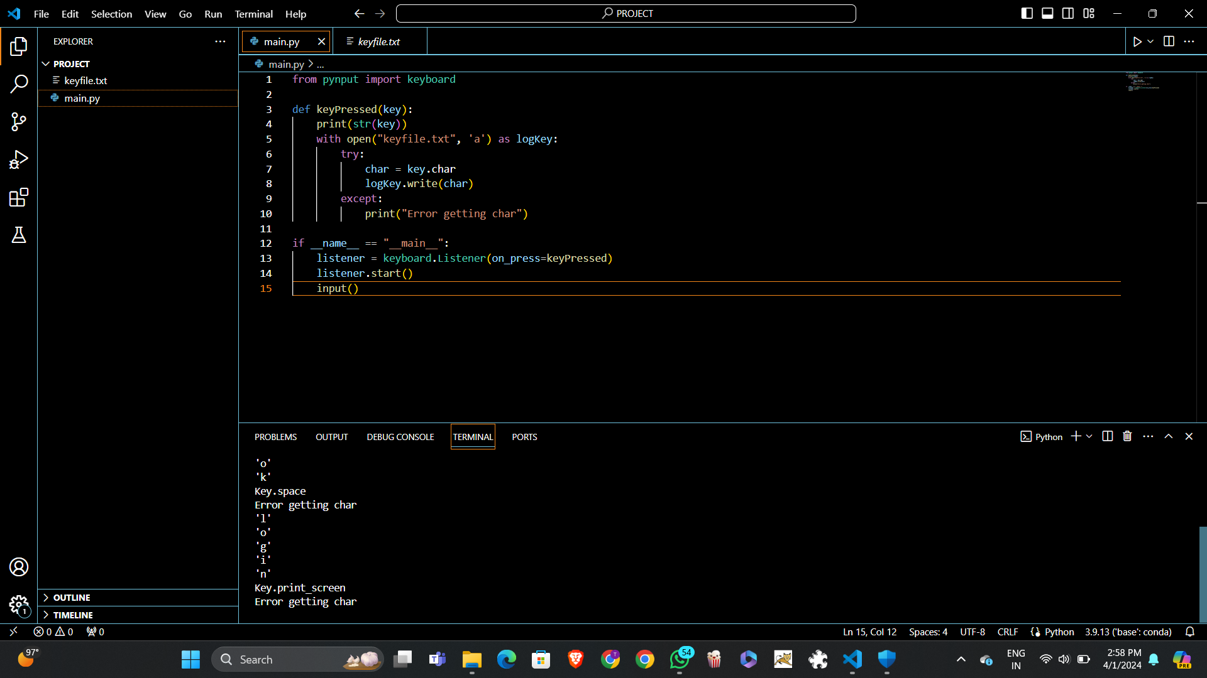
MODELLING
3/21/2024 Annual Review

Slide 11
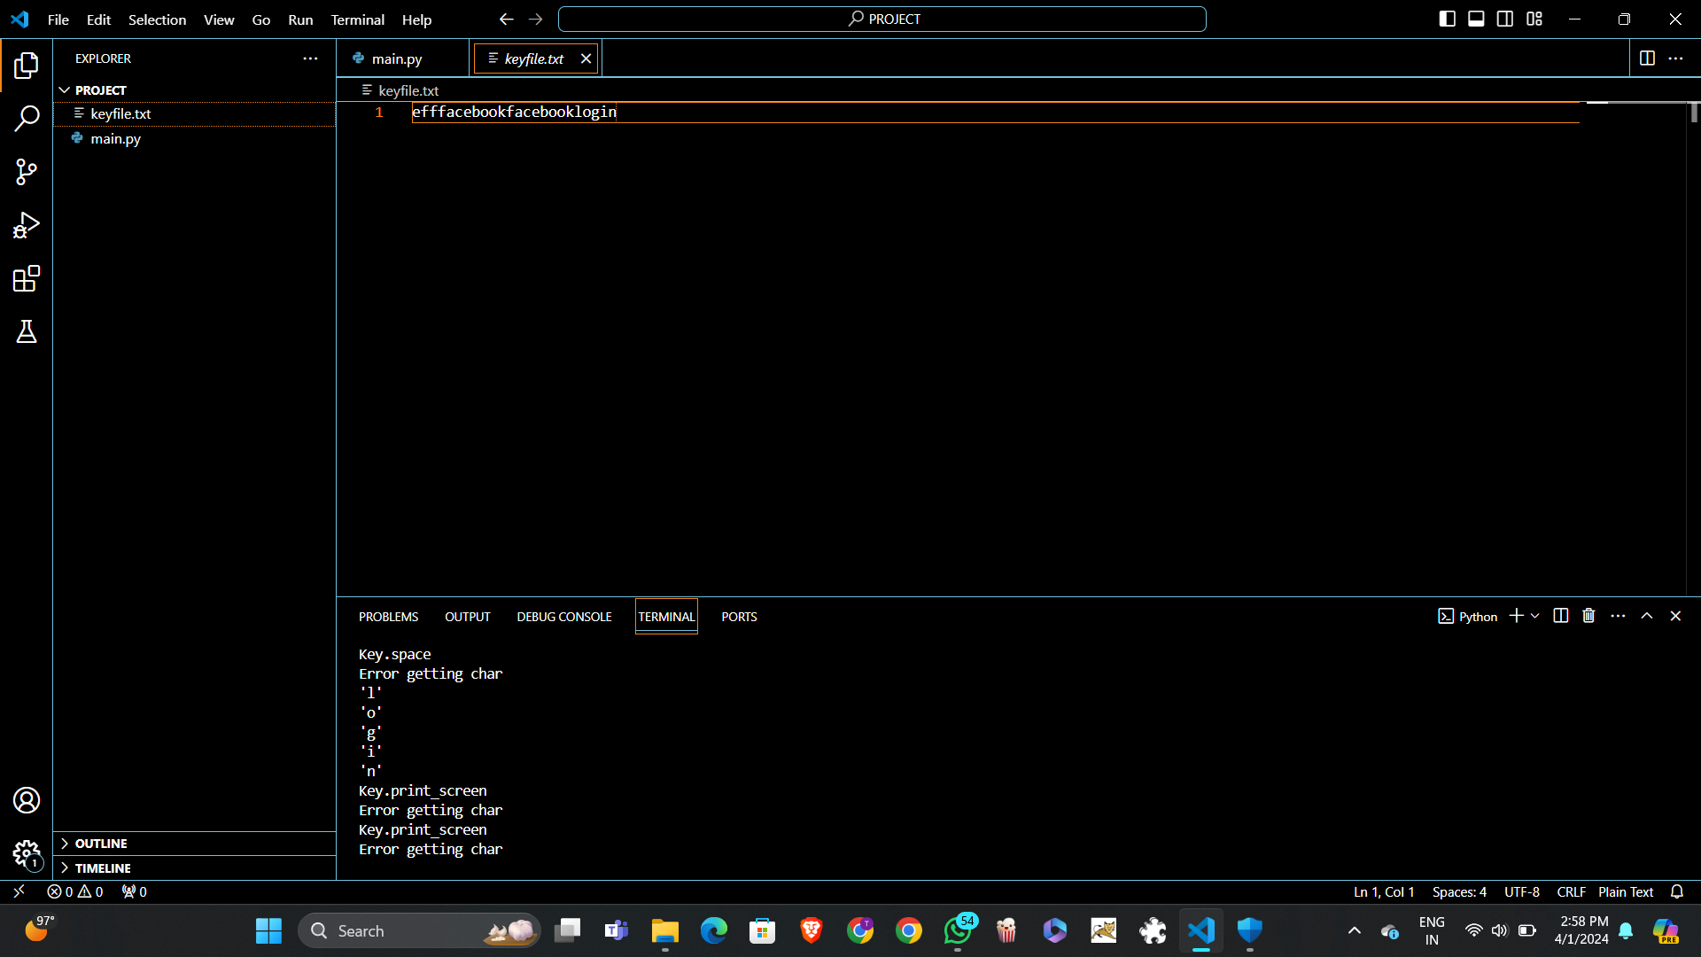
MODELLING
3/21/2024 Annual Review

Slide 12
RESULTS
The result of a keylogger project is a functional and secure software solution that enables monitoring and logging of user activities for legitimate purposes such as parental control, employee monitoring, cybersecurity, and forensic investigation. The project outcome should align with ethical principles, legal requirements, and user privacy considerations to ensure responsible use of the keylogger software.
Demo Link
3/21/2024 Annual Review

